Slide 1
Exploring SQL Server Azure Database Relationships Using Lightning Connect
Sara Morgan Nettles
Independent Software Developer/Author
@SaraHasNoLimits
Notes:
Don’t worry. Even though the title of this presentation is long and may sound a bit complicated, doing this stuff is surprisingly easy and it is actually very easy to get started.

Slide 2
Safe Harbor
Safe harbor statement under the Private Securities Litigation Reform Act of 1995:
This presentation may contain forward-looking statements that involve risks, uncertainties, and assumptions. If any such uncertainties materialize or if any of the assumptions proves incorrect, the results of salesforce.com, inc. could differ materially from the results expressed or implied by the forward-looking statements we make. All statements other than statements of historical fact could be deemed forward-looking, including any projections of product or service availability, subscriber growth, earnings, revenues, or other financial items and any statements regarding strategies or plans of management for future operations, statements of belief, any statements concerning new, planned, or upgraded services or technology developments and customer contracts or use of our services.
The risks and uncertainties referred to above include – but are not limited to – risks associated with developing and delivering new functionality for our service, new products and services, our new business model, our past operating losses, possible fluctuations in our operating results and rate of growth, interruptions or delays in our Web hosting, breach of our security measures, the outcome of any litigation, risks associated with completed and any possible mergers and acquisitions, the immature market in which we operate, our relatively limited operating history, our ability to expand, retain, and motivate our employees and manage our growth, new releases of our service and successful customer deployment, our limited history reselling non-salesforce.com products, and utilization and selling to larger enterprise customers. Further information on potential factors that could affect the financial results of salesforce.com, inc. is included in our annual report on Form 10-K for the most recent fiscal year and in our quarterly report on Form 10-Q for the most recent fiscal quarter. These documents and others containing important disclosures are available on the SEC Filings section of the Investor Information section of our Web site.
Any unreleased services or features referenced in this or other presentations, press releases or public statements are not currently available and may not be delivered on time or at all. Customers who purchase our services should make the purchase decisions based upon features that are currently available. Salesforce.com, inc. assumes no obligation and does not intend to update these forward-looking statements.

Slide 3


Sara Morgan Nettles
Independent Software Developer/Author
Custom Solutions
Notes:
I am a former Microsoft .NET Developer and I first ran across Salesforce in 2011 when I was trying to get a .NET application to communicate with Salesforce for a client. Salesforce was their system of record, but they had a .NET Portal application that needed to get case data from Salesforce. No one in the company knew much about Salesforce, so I had to get up to speed pretty quickly. In doing that, I happened to fall in love with the platform and now I probably spend more time on the Force.com platform than I do in the Microsoft world. In fact my specialty is really bridging the gap between the two and Lightning Connect it turns out happens to do this splendidly and I am hoping you will be just as excited about all this as I am.

Slide 4

Before we begin…
How many of you have worked with Lightning Connect?
How many of you have worked with SQL Server Azure?
How many of you have worked with Visual Studio?
Notes:
But first , I would like to get a quick hand count of what you guys already know about. So, first off…

Slide 5
Agenda
Overview of Lightning Connect and accessing SQL Server Azure Data
Demo: Show data in Windows Azure Portal
Demo: Creating ASP.NET Web Application
Demo: Publish Web Application to Windows Azure
Demo: Create External Data Source and Define Relationships
Summary of Gotchas
Questions

Slide 6

What is Lightning Connect?
Allow you to EASILY integrate external data with Salesforce
Expose ANY data as oData based on Open Data Protocol, version 2.0
At this time it is only one-way (read/only)
In Salesforce, you define External Data Source to access data in real-time
Define external lookup relationships in Salesforce to access related data
Notes:
oData is a web protocol for querying and updating data that is built on several popular web technologies like HTTP, the Atom publishing protocol and JSON
GOTCHA #1 – At this time one-way only, but Read/Write is coming VERY soon and is currently being piloted by some customers. And, stay tuned because I will be talking about this a bit more at the end of the session.

Slide 7
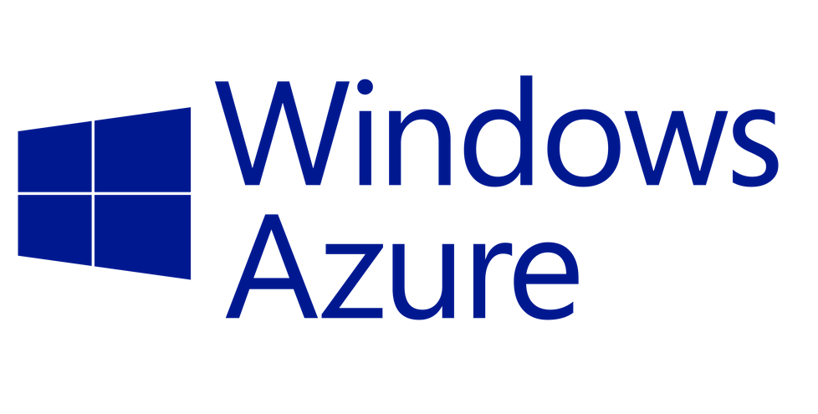
What is Windows Azure?
Cloud computing platform used to host the following:
SQL Server Databases – SQL Server Azure
Websites
Virtual Machines, Media Streaming, Active Directory, etc
You can sign up for a free one-month trial at:
https://azure.microsoft.com/en-us/pricing/free-trial/

Slide 8
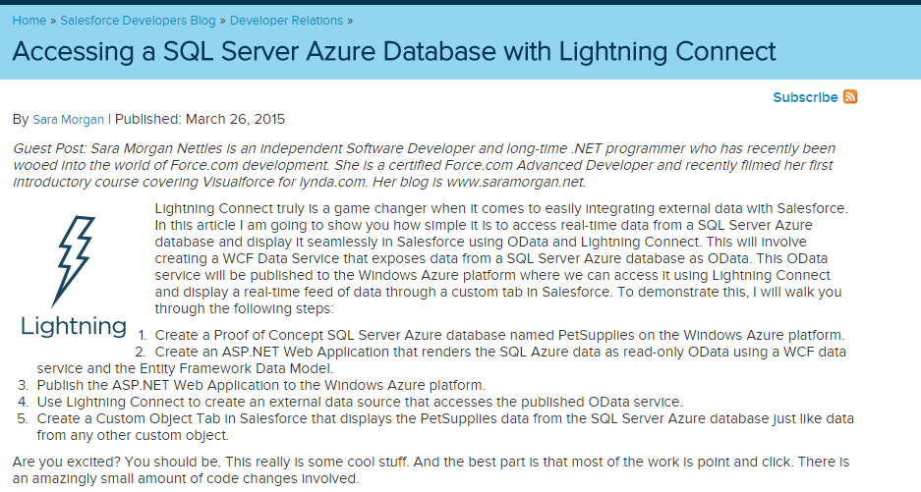
Accessing SQL Server Related Data
https://developer.salesforce.com/blogs/developer-relations/2015/03/accessing-sql-server-azure-database-lightning-connect.html

Slide 9
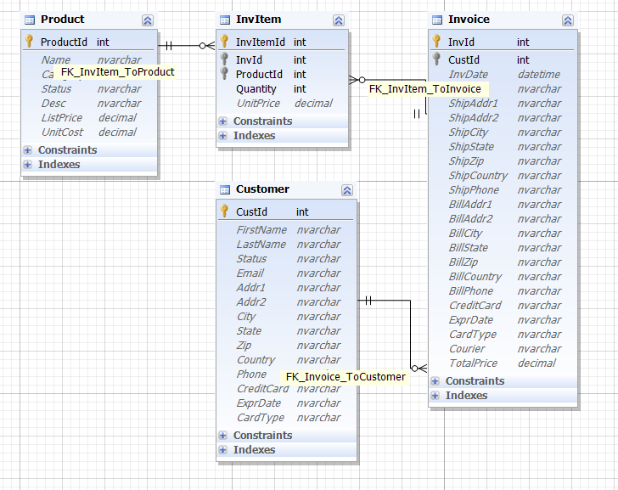
PetSupplies Relational Database Schema
Notes:
Should not be over 6 minutes at this point

Slide 10
Agenda
Overview of Lightning Connect and accessing SQL Server Azure Data
Demo: Show data in Windows Azure Portal
Demo: Creating ASP.NET Web Application
Demo: Publish Web Application to Windows Azure
Demo: Create External Data Source and Define Relationships
Summary of Gotchas
Questions
Notes:
(1 minute)
Demonstrate how they can get the Server name from the Portal
GOTCHA #2: Stress point about the need to set up Windows Azure firewall rules for this IP Address and that it will likely change everyday if they are testing from home and their network uses a dynamically assigned IP address.
Tell them they can click Open in Visual Studio to create and modify the database using Visual Studio 2015, 2013 or 2012, but they will first need to download and install it and warn them that it takes a long time to download.

Slide 11
Create an ASP.NET Application
Visual Studio Community Version 2015
Download latest free version from following URL:
https://www.visualstudio.com/en-us/downloads/download-visual-studio-vs.aspx
ASP.NET Application
Entity Framework Data Model (Object Relational Mapper) 6.x
For Visual Studio 2015, just install Microsoft.oData.EntityFrameworkProvider (Pre-release)
For Visual Studio 2012 or 2013, install WCF Data Services Entity Framework Provider (Pre-release) AND latest EntityFramework update
WCF (Windows Communication Foundation) 5.6
Notes:
(1 minute)
Entity Framework is an Object Relational Wrapper which essentially makes the task of how to get data in and out of the database much easier.
Gotcha #3: Will need to install the Microsoft oData.EntityFrameworkProvider (Pre-release) from NuGet Package Manager. Name differs depending on which version of VS you are using, and both are pre-release.
If they are using earlier version of VS (they cannot use anything prior to 2012), then the name of the EntityProvider in NuGet Package manager will be a little different and they will need to also update EntityFramework itself.
WCF or Windows Communication Foundation, which is the part that exposes the oData as a service, should already be part of Visual Studio (2012 and higher).

Slide 12
Agenda
Overview of Lightning Connect and accessing SQL Server Azure Data
Demo: Show data in Windows Azure Portal
Demo: Creating ASP.NET Web Application
Demo: Publish Web Application to Windows Azure
Demo: Create External Data Source and Define Relationships
Summary of Gotchas
Questions
Notes:
(4 minutes)
I will already have the ASP.NET Project created since this takes too long to create initially, but I will walk them through the steps of adding the Entity Data Model using the Wizard, which I can get to by right-clicking project and going to Add | New Item, selecting Data as the node and selecting EF 6.x DbContext Generate
When stepping through Wizard point out following:
Choose EF Designer From database since database already exists
Click New Connection and use string from Windows Azure portal and for demo only include sensitive data in connection string
Leave default of Entity Framework 6.x (may briefly mention about new version of Entity Framework 7.x if audience has a lot of Microsoft people in it)
Remind them that if they are using an earlier version of VS they will need to use NuGet Package Manager to update the Entity Framework package. But, they do not need to do this with VS 2015. However, they will still need to use NuGet to install Microsoft oData.EntityFrameworkProvider (pre-release). Just briefly show them where this is.
Then, start to walk them through adding the WCF Data Service 5.6.4 and just highlight the few code changes they will need to make with an existing project:
Like changing from DataService to EntityFrameworkDataService
Adding the ServiceBehavior attribute to return error details
Talk specifically about EntitySetRights and how they can be granular, but for the demo just set the * widcard

Slide 13
Publish to Windows Azure
Publishes to a website hosted on Windows Azure
Create a Web App on Windows Azure Portal and download Publish Profile
Use the Publish Web Wizard in Visual Studio to Import
Initial publish takes long time – be patient
Once published, you can access directly through a browser
https://petsuppliesrelational.azurewebsites.net/PetSuppliesRelationalData.svc
You can use query string parameters to filter and order the data directly from the browser
Customers?$filter=Addr1 eq '123 Main St'
Notes:
(1 minute)
You will first need to create a Web App on Windows Azure Portal that you can publish to. This will allow you to download a publish profile, which can then be imported into the Publish Web Wizard.
GOTCHA #4- Let me know that depending on your internet connection, the initial publish may take a long time to complete and if you try to access the hosted website before then, you will get errors (probably that the resource cannot be found).
Once published you can access data directly through your Web browser and query the data. This is also the url you will use to create your External Data Source in Salesforce.

Slide 14
Agenda
Overview of Lightning Connect and accessing SQL Server Azure Data
Demo: Show data in Windows Azure Portal
Demo: Creating ASP.NET Web Application
Demo: Publish Web Application to Windows Azure
Demo: Create External Data Source and Define Relationships
Summary of Gotchas
Questions
Notes:
(3 minutes)
I will start in Windows Azure Portal and show them that the Web App has already been created. Will then browse and show them the link to download the profile.
Make sure the output in Visual Studio shows that the publish was complete and with no errors (such as a timeout error, which happened to me several times) before attempting to see the results online. If successful, a browser window should be spawned and you will be directed to the home page of your new hosted website.
http://petsuppliesrelational.azurewebsites.net/PetSuppliesRelationalData.svc/ - shows the schema for the service
http://petsuppliesrelational.azurewebsites.net/PetSuppliesRelationalData.svc/Customers – shows all customers formatted as XML
http://petsuppliesrelational.azurewebsites.net/PetSuppliesRelationalData.svc/$metadata – shows all metadata for the service
https://petsuppliesrelational.azurewebsites.net/PetSuppliesRelationalData.svc/Customers?$filter=Addr1 eq '123 Main St‘ – filters query
Remind them that the URL string is case sensitive
If there is time, may want to mention the PragmatiQa application as a nice online tool for visualizing your oData

Slide 15
Create External Data Source in Salesforce
Create External Data Source
Development orgs limited to one
Define External Lookup Relationships
Make sure you EDIT synced fields
Query External Objects just like any other sObject
Select s.LastName__c, s.FirstName__c, (Select CustId__c, InvDate__c, Status__c, TotalPrice__c From Invoices__r) From Customers__x s
Notes:
(1 minute)
GOTCHA #5 – Will need to edit synced field to create relationship and not create a new field.
Point out the x at the end of the Customers external object

Slide 16
Agenda
Overview of Lightning Connect and accessing SQL Server Azure Data
Demo: Show data in Windows Azure Portal
Demo: Creating ASP.NET Web Application
Demo: Publish Web Application to Windows Azure
Demo: Create External Data Source and Define Relationships
Summary of Gotchas
Questions
Notes:
(5 minutes)
I will already have the External Data Source defined. Start by showing them this definition in Setup | Develop | External Objects by clicking link. I will already have it synced, but show them the External Objects listed below and point out the namespace prefix and that they might not have one.
Then click into the InvItems object and show that it already has fields defined that correspond to the fields in SQL Server and that the definition looks very similar to any other sObject.
Even though we could start querying each external object as it is now, we need to specifically define relationships in order to access the data using the one to many relationships we saw defined in SQL Server.
You do this by editing the existing and creating an External Lookup Relationship. Show then this by editing the InvId field in the InvItems object and creating External Lookup Relationship to Invoices
Then do a query in the Query Editor of Developer Console.

Slide 17
Summary of Gotchas
At this time one-way only (read/only), but writable access coming soon
Will need to add firewall rules in Windows Azure (possibly daily)
Need to install Entity Framework Provider from NuGet Package Manager
Initial publish can take a long time (be patient)
Will need to define relationships specifically by editing synced fields (NOT creating new ones)
See here for more info on Gotchas:
http://saramorgan.net/2015/04/14/gotchas-when-working-with-sql-server-azure/
Notes:
(3 minutes)
I have been told that Writable CRUD for oData and Apex Connector will be available sometime in Winter 16 (October 16) and the writable CRUD for Salesforce Connector will become available in Spring 16 (Feb 2016)
If time, may want to discuss how they could alter permissions by returning to the application in .NET and showing the different types of configuration they could do using the EntitySetRights

Slide 18

Q & A
Notes:
(5 minutes)

